Slide 1
My Hive Died – Now What?
How to Store Equipment
Huguenot Beekeepers Association

Slide 2
Preparing for Storage
Freeze frames for 48 hours or longer
Kills eggs/larvae that may be on the frames
Be sure to either loosely bag or put something under the frames to contain mess
Dry out frames after freezing
Use a fan or dehumidifier
Opportunity to cycle out any old frames
Reclaim wax for other uses

Slide 3
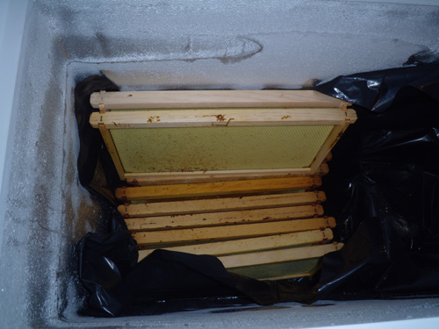
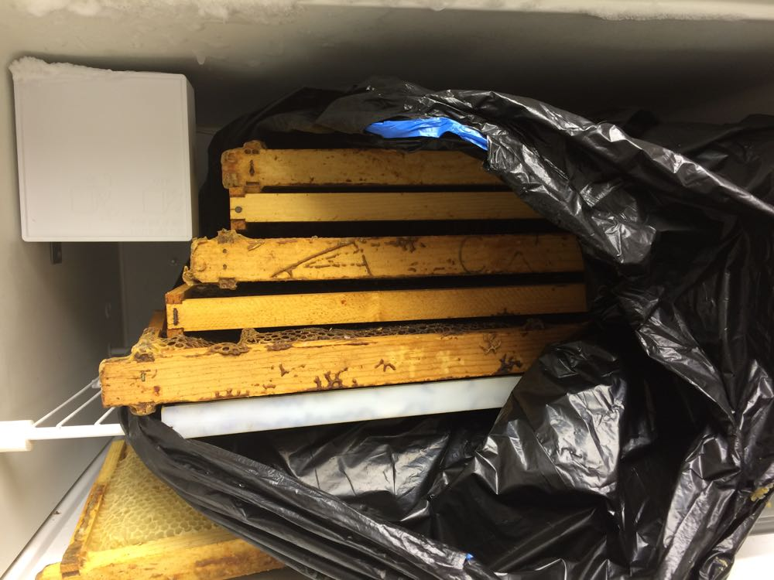
Freezing Frames

Slide 4
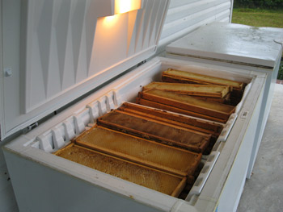
Storing Equipment
Storage options
Freezer
Good for frames with honey
Can keep in freezer indefinitely

Slide 5
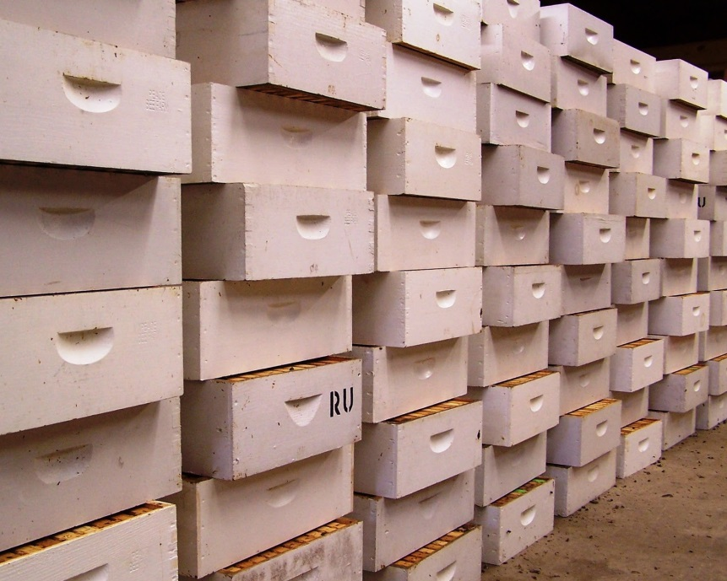
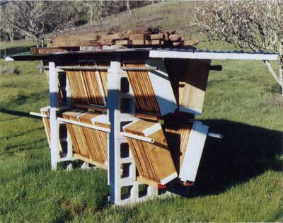
Storing Equipment
Storage options
Cross stack in well lit area with fresh air flow
Build a rack to expose supers to sunlight and protect from rain.

Slide 6
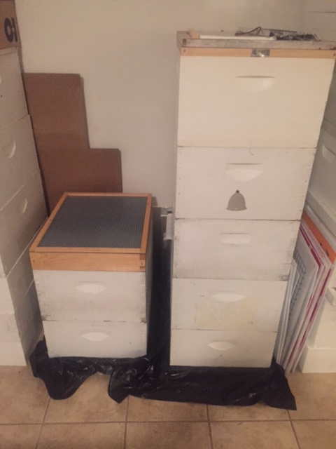
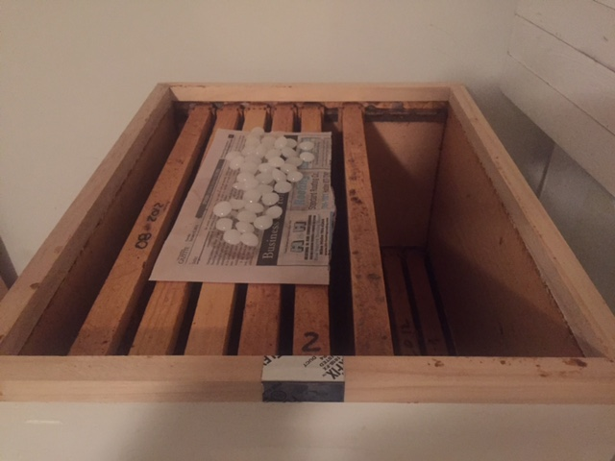
Storing Equipment
Storage options
Para-Moth crystals (moth balls)
Paradichlorobenzene (PDB)
DO NOT use naphthalene – toxic to bees
Stack sealed
Air out before reusing.

Slide 7
Questions?

